Slide 1
Web Scraping for E-commerce Market Analysis

Slide 2
AGENDA
Introduction
Overview of the project’s significance in e-commerce market analysis.
Introduction
Overview of the project’s significance in e-commerce market analysis.
Introduction
Objective
Methodology
Case Studies
Challenges
Expected Outcomes
Conclusion

Slide 3
Introduction
Overview of the project’s significance in e-commerce market analysis.

Slide 4
Introduction
Background: E-commerce businesses face intense competition and need real-time data on competitor pricing, product reviews, and customer sentiment to stay ahead.
Significance: Web scraping helps in automating the collection of large amounts of data from e-commerce platforms, enabling businesses to make informed decisions.
Market Research Goal: Develop a web scraper capable of gathering essential data like product prices, reviews, and competitor strategies from multiple online platforms.

Slide 5

Objective
Purpose of developing a web scraping tool for extracting and analyzing data.

Slide 6
Introduction
Primary Goal: Design and implement an efficient web scraping tool to collect data from e-commerce websites like Amazon and Flipkart.
Data Utilization:
Price Comparison: Analyze pricing across platforms to offer insights into competitive pricing strategies.
Sentiment Analysis: Gather and analyze customer reviews to understand product feedback and quality.
Competitor Insights: Identify key competitors and analyze their offerings to stay competitive.

Slide 7
Methodology
Tools, techniques, and libraries used in the project.
Approach to data extraction and handling dynamic content.

Slide 8

Methodology
Tools Used:
Python: The primary programming language for web scraping.
BeautifulSoup & Scrapy: Libraries for HTML parsing and web scraping.
Data Handling:
Scraping structured data (prices, ratings) and unstructured data (reviews) from dynamic websites.
Store the collected data in CSV or JSON formats for further processing.
Advanced Analytics: Data will be imported into Power BI to generate detailed visualizations and insights.

Slide 9
Challenges
Key difficulties in scraping data, such as anti-scraping measures and large datasets.

Slide 10
Challenges
Anti-Scraping Measures: Many websites implement barriers to scraping, such as CAPTCHAs and IP blocks.
Dynamic Content: E-commerce platforms often use JavaScript to load data, which requires careful handling.
Large Datasets: Managing and processing vast amounts of data while ensuring the scraper performs efficiently.

Slide 11

Case Study

Slide 12
Case Study 1: Sunscreen Price Comparison
Data Comparison:
Analyzed product prices and ratings between Amazon and Flipkart.
Identified the top-rated products and pricing differences.
Key Insights:
Pricing strategies differed between platforms for identical products.
Visualizations showed the top-performing and worst-performing products based on customer reviews.

Slide 13
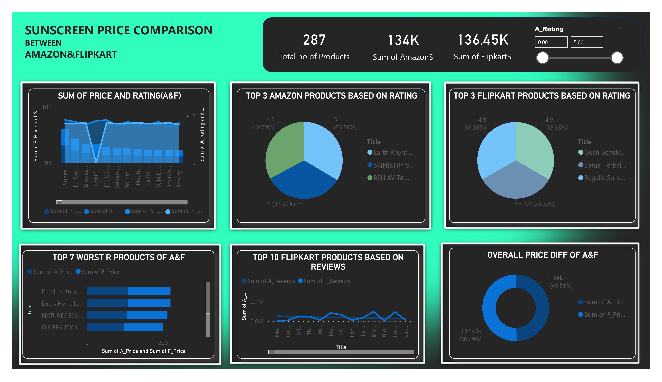
Case Study 1: Sunscreen Price Comparison
Data Comparison:
Analyzed product prices and ratings between Amazon and Flipkart.
Identified the top-rated products and pricing differences.
Key Insights:
Pricing strategies differed between platforms for identical products.
Visualizations showed the top-performing and worst-performing products based on customer reviews.

Slide 14
Case Study 2: Laptop Price Comparison
Data Comparison:
Similar analysis done for laptops, including pricing and rating comparisons.
Key Insights:
Certain brands performed better on specific platforms.
Price variations were notable, providing insights into pricing strategy effectiveness.

Slide 15
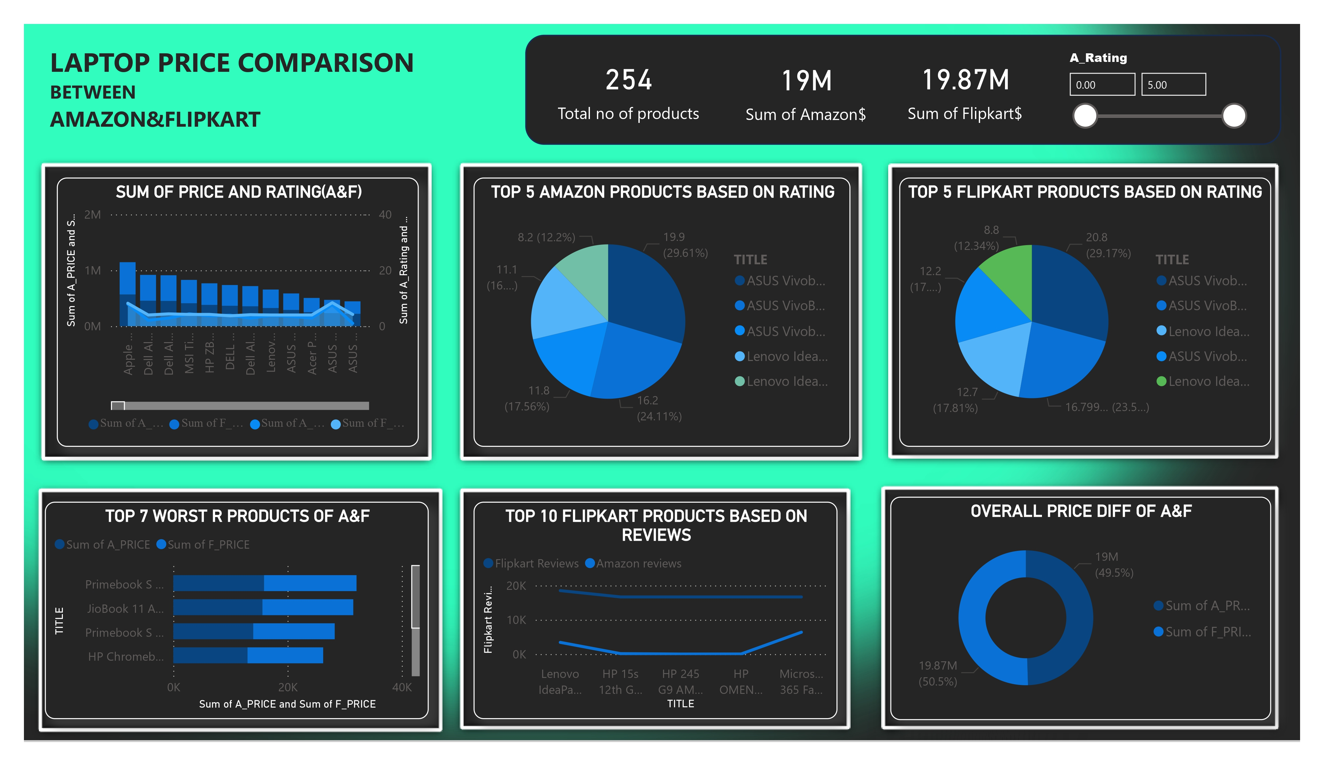
Case Study 1: Sunscreen Price Comparison
Data Comparison:
Analyzed product prices and ratings between Amazon and Flipkart.
Identified the top-rated products and pricing differences.
Key Insights:
Pricing strategies differed between platforms for identical products.
Visualizations showed the top-performing and worst-performing products based on customer reviews.

Slide 16
Case Study 3: Smartphone Price Comparison
Data Comparison:
Analyzed smartphone pricing, ratings, and reviews on both platforms.
Key Insights:
The analysis highlighted differences in product reviews and pricing trends, giving insights into platform-specific product performance.

Slide 17
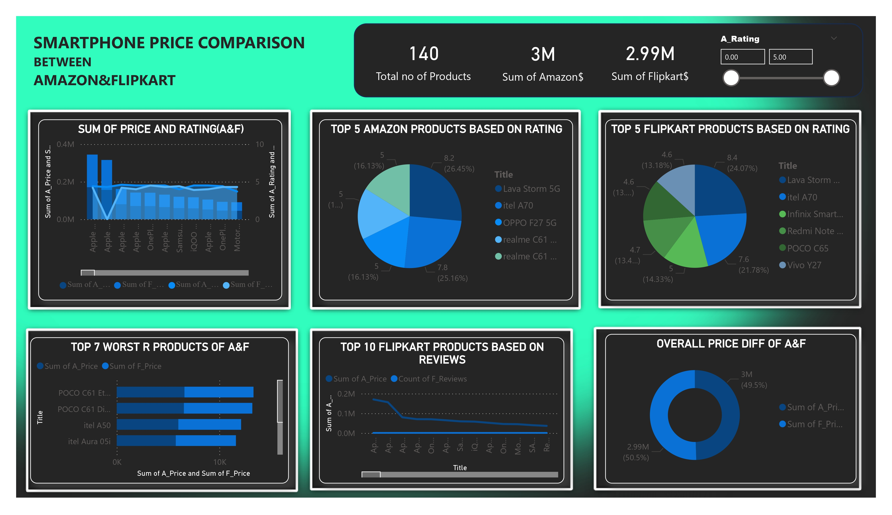
Case Study 1: Sunscreen Price Comparison
Data Comparison:
Analyzed product prices and ratings between Amazon and Flipkart.
Identified the top-rated products and pricing differences.
Key Insights:
Pricing strategies differed between platforms for identical products.
Visualizations showed the top-performing and worst-performing products based on customer reviews.

Slide 18
Case Study 3: Smartphone Price Comparison
Data Comparison:
Analyzed smartphone pricing, ratings, and reviews on both platforms.
Key Insights:
The analysis highlighted differences in product reviews and pricing trends, giving insights into platform-specific product performance.

Slide 19
Case Study 1: Sunscreen Price Comparison
Data Comparison:
Analyzed product prices and ratings between Amazon and Flipkart.
Identified the top-rated products and pricing differences.
Key Insights:
Pricing strategies differed between platforms for identical products.
Visualizations showed the top-performing and worst-performing products based on customer reviews.

Slide 20
Case Study 4: Perfume Price Comparison
Data Comparison:
Analyzed perfume pricing, ratings, and reviews on both platforms.
Key Insights:
Price differences were noted between luxury and budget perfumes.
Top-rated brands identified for each platform.
Customer reviews varied across platforms, indicating different audience preferences.

Slide 21
Case Study 1: Sunscreen Price Comparison
Data Comparison:
Analyzed product prices and ratings between Amazon and Flipkart.
Identified the top-rated products and pricing differences.
Key Insights:
Pricing strategies differed between platforms for identical products.
Visualizations showed the top-performing and worst-performing products based on customer reviews.

Slide 22
Expected Outcomes
Insights gained from web scraping and their application in business strategy.
Insights gained from web scraping and their application in business strategy.

Slide 23
Expected Outcomes
Comprehensive Dataset:
Collected data will include product prices, reviews, and competitor information across platforms.
Data Analysis & Reports:
Power BI will be used for visualization, providing actionable insights into product pricing, competitor strategies, and customer satisfaction.
Strategic Decisions:
Businesses can use this data to make informed decisions about product pricing, marketing, and customer targeting.

Slide 24
Conclusion
Summary of the web scraping tool’s benefits and overall impact on market analysis.

Slide 25
Conclusion
Automation of Data Collection: The web scraper will streamline data collection, reducing the manual effort involved in market research.
Business Impact: Businesses can use real-time insights to stay competitive, adjust pricing strategies, and understand customer sentiments.
Future Applications: The tool can be expanded to cover more e-commerce platforms, product categories, and advanced analytics like forecasting trends.

Slide 26
Thank you

